Slide 1
RNA

Slide 2
Gene – section of DNA that are coded instructions for the cell
The instructions are to make proteins, which in turn run and carry out processes in the cell
RNA is needed to help carry out the code.

Slide 3
RNA is made of nucleotides like DNA. There are a few differences….
5 carbon sugar – ribose (instead of deoxyribose)
Phosphate group
Nitrogen base- NO THYMINE (T)
instead is uracil (U)
A-U

Slide 4
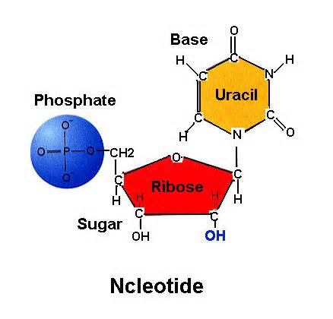
o

Slide 5
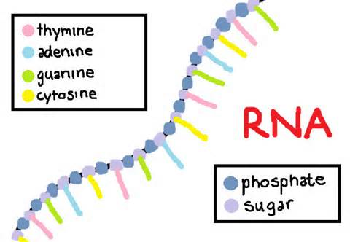
RNA is a single strand
What is wrong with this pic?

Slide 6
There are 3 Types of RNA
mRNA- messenger RNA
copies code of DNA and delivers it
rRNA- ribosomal RNA
part of ribosome
tRNA- transfer RNA
carries amino acid coded for to build protein

Slide 7
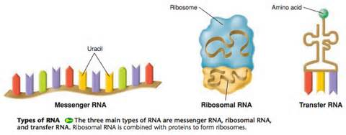
n

Slide 8
Protein Synthesis
For DNA to create a protein there are 2 major steps:
1. Transcription
2. Translation

Slide 9
TRANSCRIPTION
DNA is copied into mRNA in the nucleus
(*DNA NEVER leaves the nucleus)
mRNA carries the code outside the nucleus to the ribosome to be read

Slide 10
TRANSLATION
mRNA is read by the ribosome—in the cytoplasm!
The code “calls” for specific amino acids to join to create a protein
Amino acids brought into place by tRNA

Slide 11
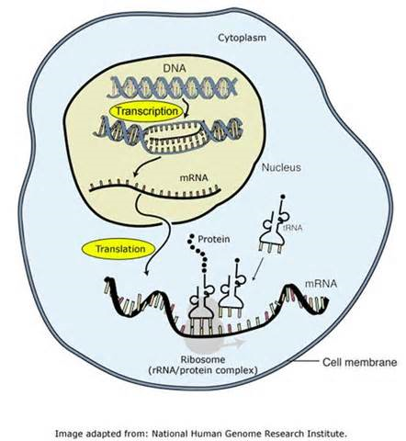
j

